Slide 1
Flash Carma Project Update
by Adrian West, Brandon Sitz, Joseph Ramos-Garcia, and Josh Moore

Slide 2
Outline
Significant Changes
In Development
Yet To Be and Currently Finished
Potential Issues and Solutions
Updated Diagrams
Closing and Questions

Slide 3
Significant Changes
Mostly consistent with proposal
Fewer pop-ups
Merging of Profile and Settings
Search feature moved to post-semester

Slide 4
Significant Changes
Technologies Not Needed
Tailwind CSS
Express
Premade databases

Slide 5
In-Development
Navigation Bar
Links need to be routed and image for home to implement
View Study Decks Page
Pseudo code and some functions completed
Implementation of remaining functions
Testing and revision

Slide 6
In-Development
Edit Page
Format skeleton complete
Needs database support
Read/Write to database
Update screen with database info

Slide 7
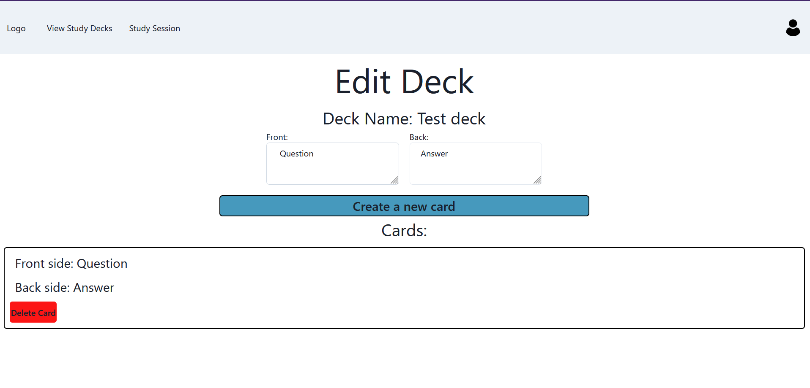
In-Development
Edit Page

Slide 8
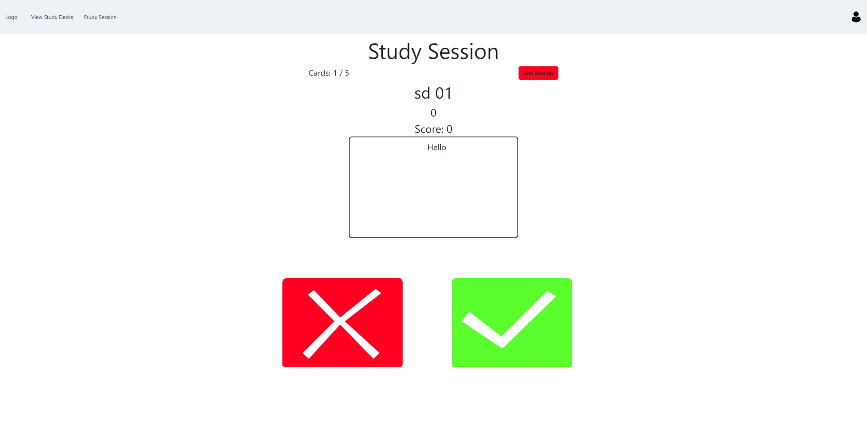
In-Development
Study Session Page
Functionality is generally complete

Slide 9
Yet To Be Finished
Study Deck Selection Page
Select a study deck to study
Profile Page
User logout
Modify user information
UI settings

Slide 10
Currently Finished
Majority of the Firebase functions
Retrieving, adding, and deleting data
User authentication
Creating a user
Results Page

Slide 11
Potential Issues and Solutions
Passing data between separate pages
React Context API
Store information in a global state that any component can access
Reaching Firebase Limit
Upgrading to Blaze Plan

Slide 12
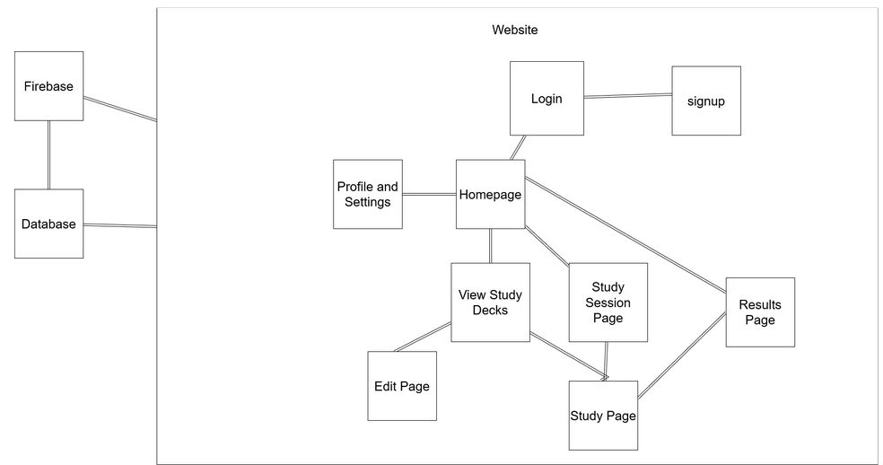
Updated Block Diagram

Slide 13
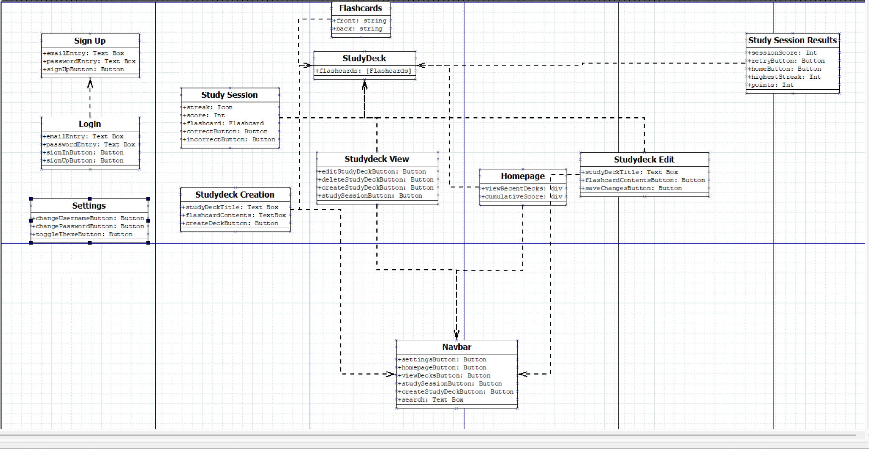
Updated Component Diagram

Slide 14
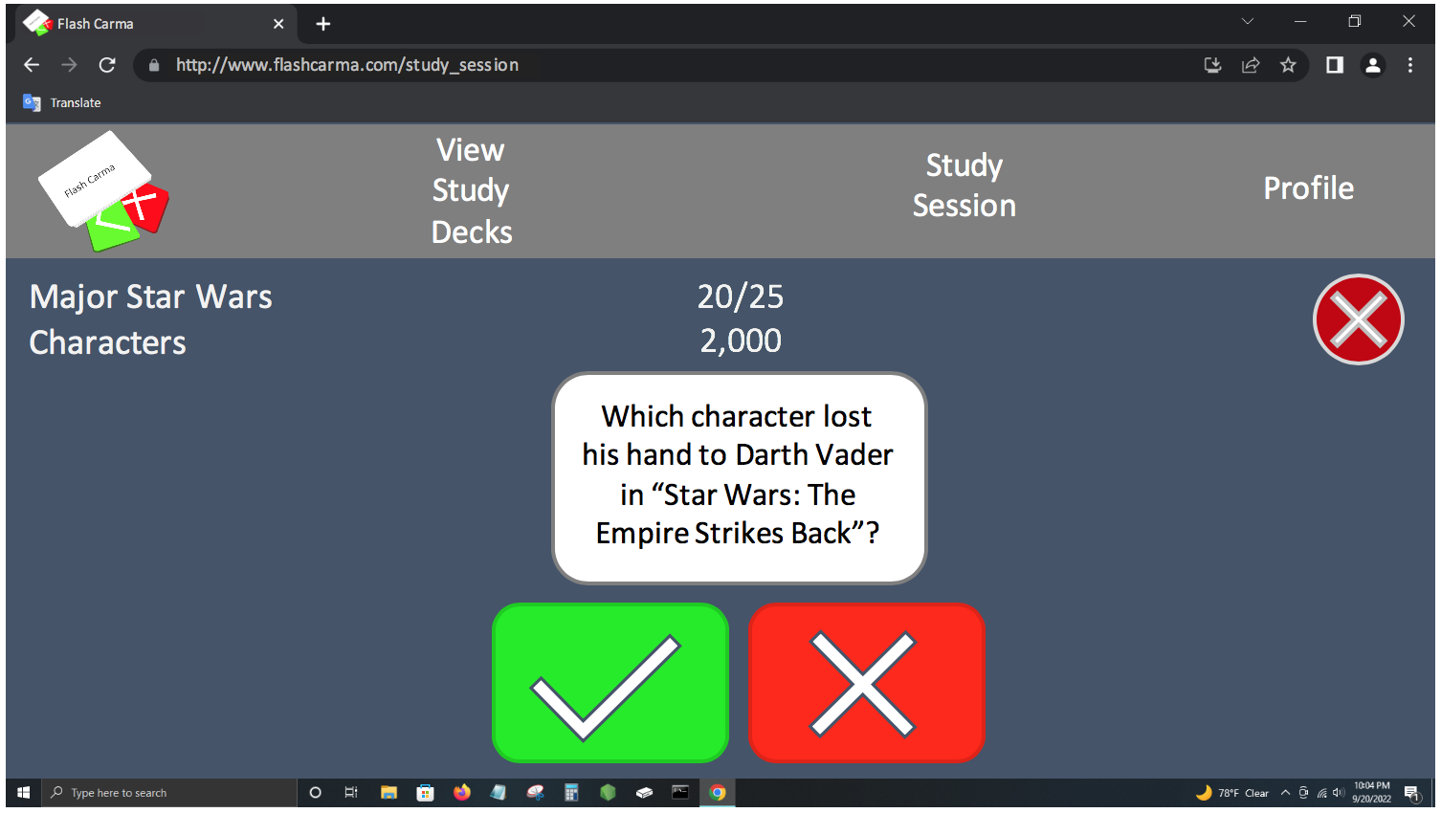
Updated User Interface Storyboard

Slide 15
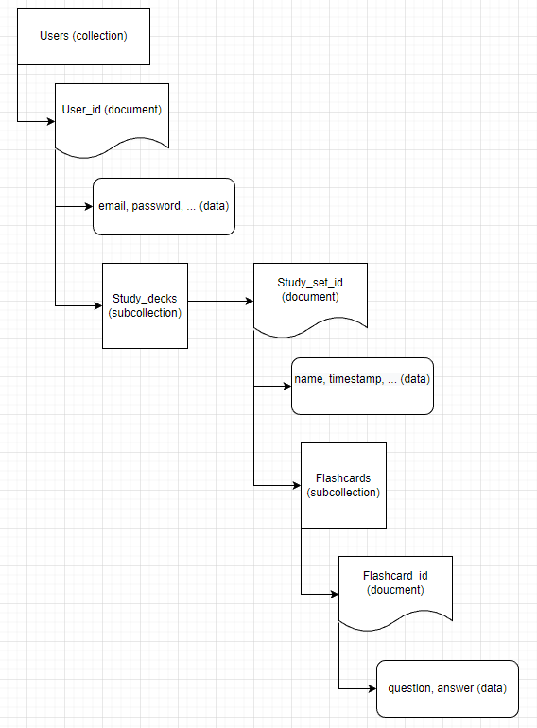
Updated Data Model

Slide 16
Summary
Significant Changes
In Development
Yet To Be and Currently Finished
Potential Issues and Solutions
Updated Diagrams
Closing and Questions

Slide 17
Closing
Questions
Comments
Concerns
Thank you for your time!

